Slide 1

CMS Claims and Provider Data Analysis
Praveen Perumal Ramanpillai
Colorado State University - Global
MIS581 - Capstone - Business Intelligence and Data Analytics
Instructor: Chung, Steve
July 6, 2025
Notes:
Today, I’ll walk you through critical findings from my capstone project analyzing Medicaid and Medicare data. Our goal is to identify actionable opportunities to enhance access, efficiency, and equity in value-based care delivery.

Slide 2
Project Objectives
Evaluate
Evaluate provider availability vs. patient access
Identify
Identify care intensity by plan categories
Analyze
Analyze utilization trends across states
Compare
Compare Medicare payments vs. charges
Assess
Assess urban-rural disparities
Notes:
We sought to evaluate provider network adequacy, plan performance on care intensity, state-level utilization trends, reimbursement gaps, and disparities between urban and rural settings—insights essential for improving patient outcomes and financial sustainability.

Slide 3
Research Questions
Does provider availability increase patient access?
Which plans deliver more services per patient?
How do service trends vary by state?
Are there discrepancies between Medicare payments and charges?
Which DRGs have the highest total discharges and payments?
Do urban and rural providers differ in payments?
Notes:
Our targeted questions focus on provider access, plan efficiency, regional utilization patterns, Medicare reimbursement misalignments, and urban-rural inequities. These are core areas where we can act to drive value.

Slide 4
Data Sets and Tools Used
Data Sets used:
Medicaid Managed Care datasets
Medicare IP Hospitals by Geography and Service
Medicare IP Hospitals by Provider and Service
Tools Used:
SAS Studio
Python (Jupyter)
PostgreSQL
Excel
Notes:
Our targeted questions focus on provider access, plan efficiency, regional utilization patterns, Medicare reimbursement misalignments, and urban-rural inequities. These are core areas where we can act to drive value.

Slide 5
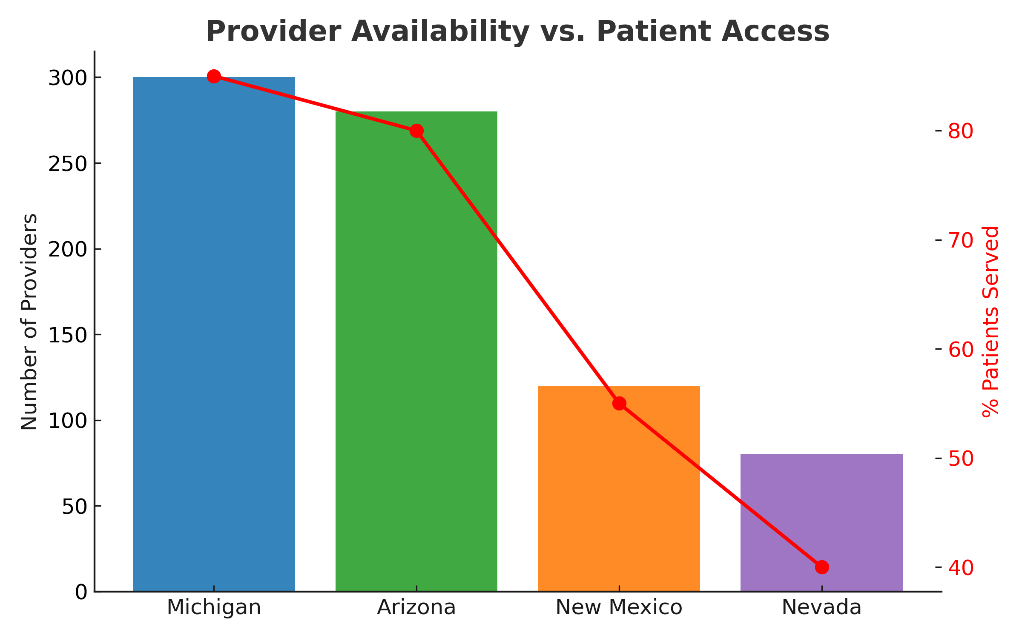
Provider Availability & Access
Notes:
Our analysis revealed a direct link between provider density and patient service rates. Regions like Michigan and Arizona achieved significantly higher coverage than rural counties—underscoring the need to expand provider networks in underserved areas.

Slide 6
Services per Active Patient by Plan
Notes:
Comprehensive MCOs excel in serving large patient bases with diverse services. Specialty plans play key roles in behavioral and pediatric care. Our strategies should maintain comprehensive coverage while strengthening specialty services to address high-risk needs.

Slide 7
Utilization Trends by State
Notes:
Michigan leads in both active patient numbers and service growth, reflecting a robust care model. Nevada lags, signaling potential policy or provider network gaps. Regional strategies must prioritize underperforming states to reduce disparities.

Slide 8
Medicare Payments vs. Charges
Notes:
Significant gaps exist between billed charges and Medicare payments—averaging a 4–5x difference in high-cost DRGs. This suggests inefficiencies in revenue cycle management, calling for improved negotiation, documentation, and coding practices.

Slide 9
High-Volume DRGs & Discharges
Notes:
“Cardio/Pulmonary” dominate discharge volumes but differ in financial impact. Focusing process improvement efforts on high-volume categories can optimize resource use and patient outcomes.

Slide 10
Urban vs. Rural Disparities
Notes:
Urban areas capture nearly 400x more in Medicare payments than rural providers, despite rural populations often having greater health needs. Addressing these disparities requires targeted investment in rural healthcare infrastructure and provider recruitment.

Slide 11
Hypotheses Outcomes
Plan types impact service delivery intensity
Significant Medicare payment-to-charge gaps exist
Care intensity varies by plan & geography
Urban vs rural differences in discharges are significant
Notes:
We rejected all null hypotheses: plan type, region, and provider location significantly impact care intensity, payments, and utilization. This confirms the need for nuanced, data-driven strategies instead of one-size-fits-all approaches.

Slide 12
Conclusion & Implications
VBC improves quality and efficiency. But it can increase disparities if incentives and providers don’t match patient needs.
States with more providers, like Michigan, have better coverage and care intensity.
Rural areas still face big access gaps.
Large differences exist between Medicare payments and charges.
Urban areas have much higher service volumes than rural areas.
VBC programs must address these gaps to ensure fair, quality care for all patients.
Notes:
Our findings highlight that value-based care can enhance outcomes but risks widening disparities if financial incentives and provider distribution aren’t realigned with community needs. Prioritizing underserved regions will ensure equitable, sustainable improvements in care.

Slide 13
References
Zhou, R. A., Beaulieu, N. D., & Cutler, D. (2020). Primary care quality and cost for privately insured patients in and out of US Health Systems: Evidence from four states. Health Services Research, 55(Suppl S3), 1098–1106.
Lin, S. C., Funk, R. J., Ryan, A. M., Joynt Maddox, K. E., & Hollingsworth, J. M. (2024). Bundled payments lead to quality improvements in hospitals' skilled nursing facility referral networks. American Journal of Managed Care, 30(6), e184–e190.
Chen, A. C., Grabowski, D. C., & Trish, E. (2025). Medical loss ratios’ role in the large group insurer market. American Journal of Managed Care, 31(1), 33–36.
Mallow, P. J., Belk, K. W., Topmiller, M., & Strassels, S. A. (2018). Geographic variation in hospital costs, payments, and length of stay for opioid-related hospital visits in the USA. Journal of Pain Research, 11, 3079–3088.
Holt, J. B., Zhang, X., Presley-Cantrell, L., & Croft, J. B. (2011). Geographic disparities in chronic obstructive pulmonary disease (COPD) hospitalization among Medicare beneficiaries in the United States. International Journal of Chronic Obstructive Pulmonary Disease, 6, 321–328.
Neyman, J., & Pearson, E. S. (1933). On the problem of the most efficient tests of statistical hypotheses. Philosophical Transactions of the Royal Society of London. Series A, Containing Papers of a Mathematical or Physical Character, 231, 289–337.
Shmueli, G., Bruce, P. C., & Patel, N. R. (2016). Data mining for business analytics: Concepts, techniques, and applications with XLMiner (3rd ed.). Wiley.
Cooper, Z., Stiegman, O., Ndumele, C. D., et al. (2019). Geographical variation in health spending across the US among privately insured individuals and enrollees in Medicaid and Medicare. Health Affairs, 38(2), 189–199.
World Medical Association. (2013). WMA Declaration of Helsinki – Ethical principles for medical research involving human participants. Retrieved from https://www.wma.net/policies-post/wma-declaration-of-helsinki-ethical-principles-for-medical-research-involving-human-subjects/
U.S. Department of Health and Human Services. (2015). Your rights under HIPAA. Retrieved from https://www.hhs.gov/hipaa/for-individuals/guidance-materials-for-consumers/index.html

